Slide 1

On Recovering IP Information from airborne time domain EM Data
Seogi Kang*, Doug Oldenburg, David Marchant, and Dikun Yang

Slide 2
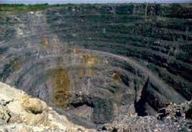

Induced polarization
Exploration of massive sulphide deposits
(Mining application)
VTEM
IP responses in Airborne
Time domain EM (ATEM)
Coincident loop
Measure db_{z}/dt
Field example: Mt. Milligan data

Slide 3
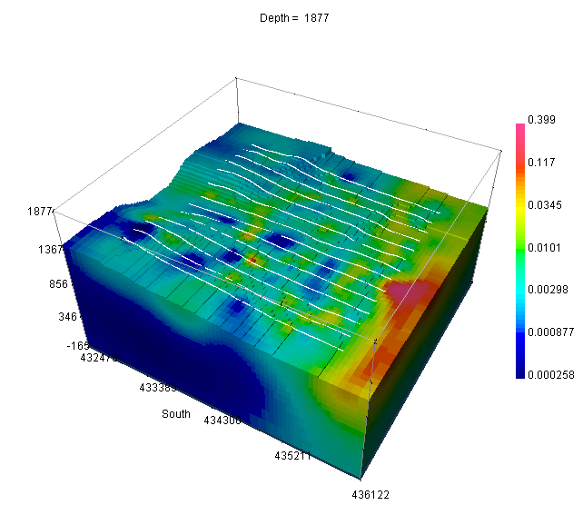
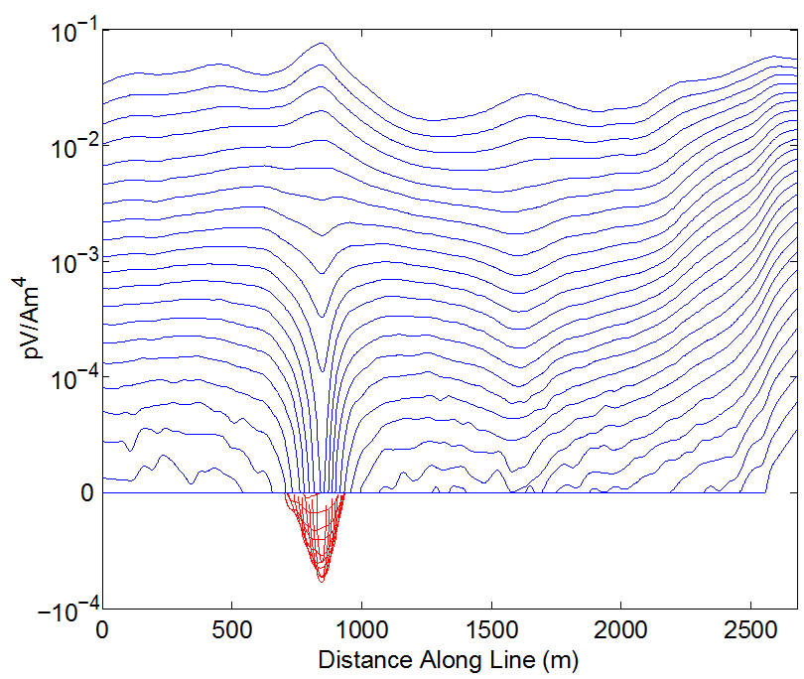
Field example: Mt. Milligan VTEM
Recovered 3D conductivity model
Negative transients of db/dt
Existence of IP body
Yang et al., 2012
Observed data (db/dt)
(Weidelt, 1982)
Geotech (2007)
Notes:
From the data we observe the effects of the large negative but there are also other minima.
Unfortunately there seems to be systematic biases and we’ve attempted to remove these with the idea that the broad background should be non-chargeable. This is akin to removing a regional and there is the possibiity of throwing the baby out with the bathwater.
Persevere to get …

Slide 4
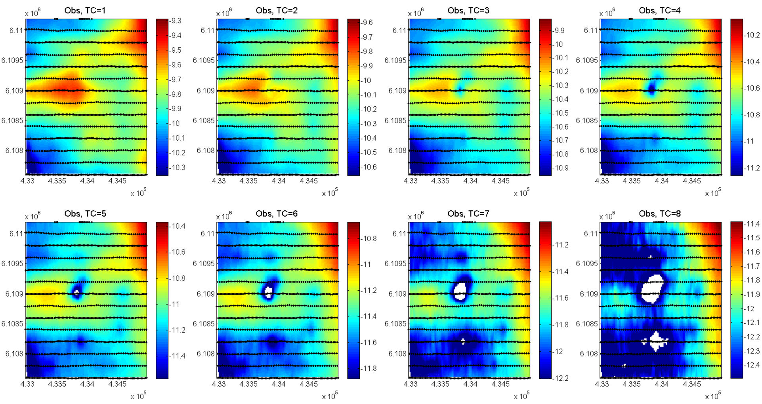
Observed data for all channels
We can “measure” negative transients in the field data (VTEM)
, but only can identify in “late time” channels
Notes:
Need to change Figures: Rerun forward modeling based on more sources?
- Need to play with interpolation

Slide 5
Outline
Backgrounds
Build up conceptual model and verify
Suggest some ways to process and invert IP responses in VTEM data
Conclusions and the path ahead

Slide 6
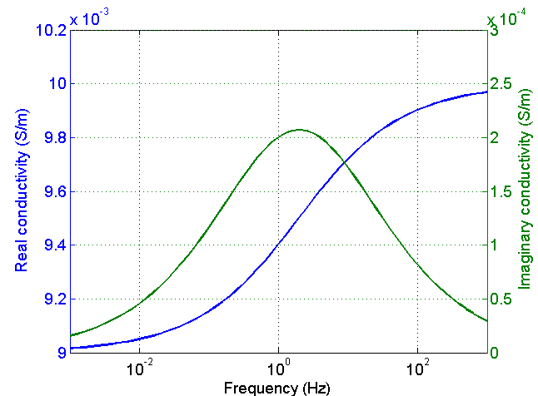
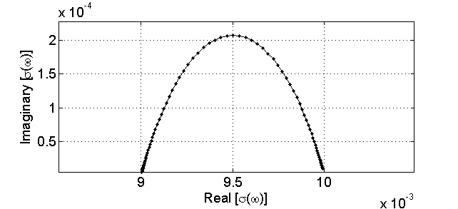
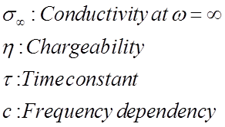
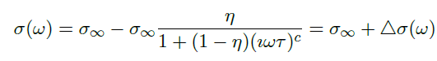
Conductivity is frequency dependent
Cole-Cole model
ω=0
ω=∞
Backgrounds
Conceptual model
d^{IP} responses
Linear inversion
Mt. Milligan data

Slide 7
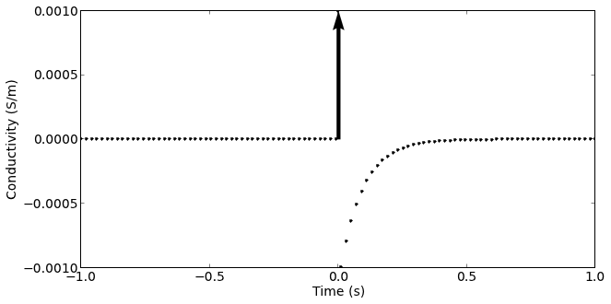
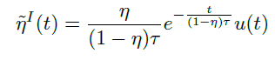
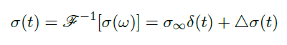
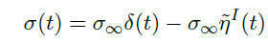
Conductivity is time dependent
Assuming Cole-Cole model for c = 1
Intrinsic pseudo-chargeability
σ∞δ (t)
∆σ(t)
Backgrounds
Conceptual model
d^{IP} responses
Linear inversion
Mt. Milligan data

Slide 8
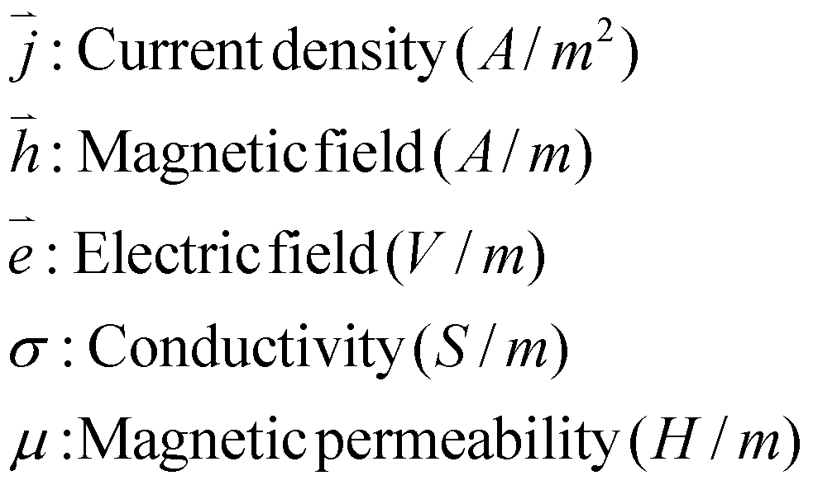
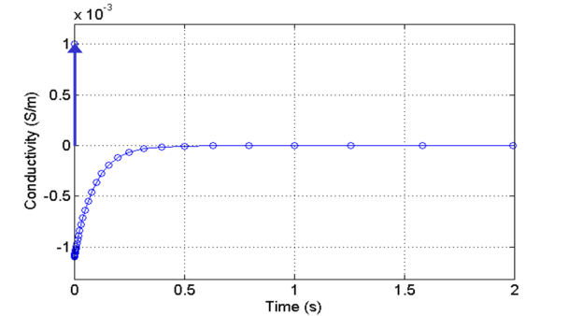
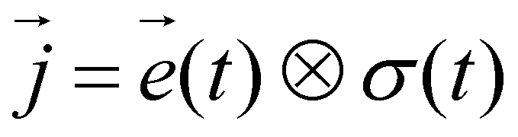

Background
Maxwell’s equations in time
σ (ω)
Ohm’s law in frequency domain
Ohm’s law in time domain
σ (t)
Backgrounds
Conceptual model
d^{IP} responses
Linear inversion
Mt. Milligan data
Notes:
From abstract and elsewhere

Slide 9
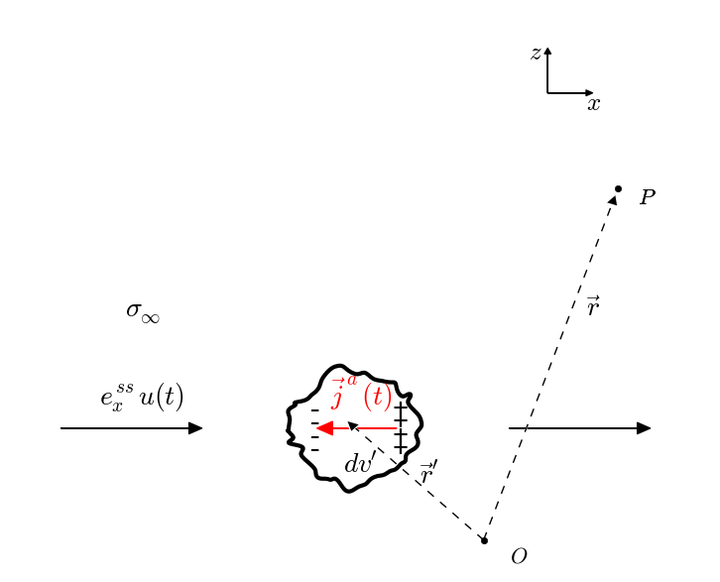
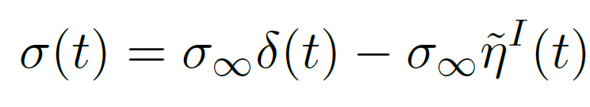
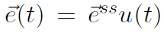
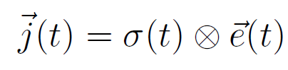
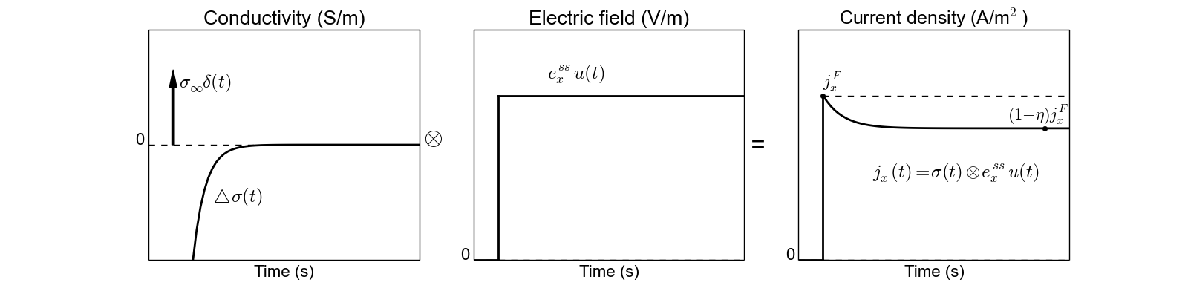
Convolution approach
Backgrounds
Conceptual model
d^{IP} responses
Linear inversion
Mt. Milligan data
Notes:
Modify Ja as Jip

Slide 10
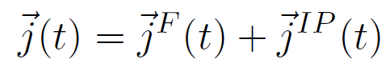
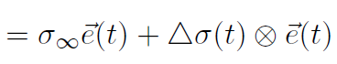

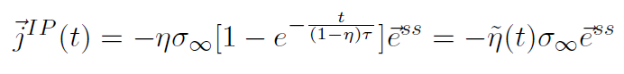
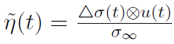
Convolution approach
J^{IP} has opposite direction to J^{F}
Magnitude of J^{IP} is proportional to pseudo chargeability
Backgrounds
Conceptual model
d^{IP} responses
Linear inversion
Mt. Milligan data

Slide 11
Conceptual model
J^{IP} has opposite direction to J^{F}
Magnitude of J^{IP} is proportional to pseudo chargeability
Backgrounds
Conceptual model
d^{IP} responses
Linear inversion
Mt. Milligan data

Slide 12
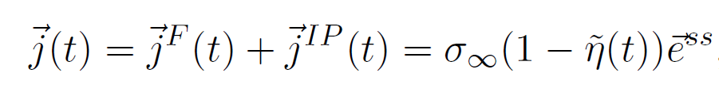
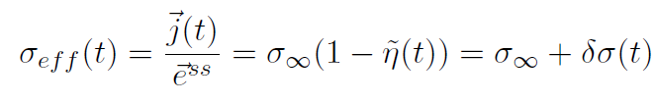
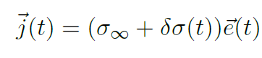
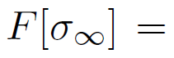
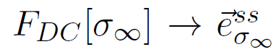
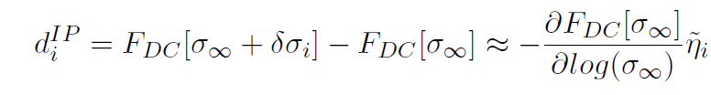
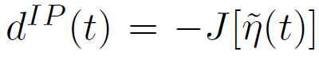
Linearization in EIP or MIP
Backgrounds
Conceptual model
d^{IP} responses
Linear inversion
Mt. Milligan data

Slide 13
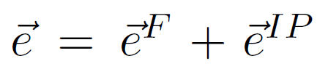
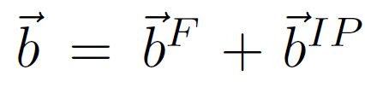
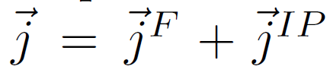
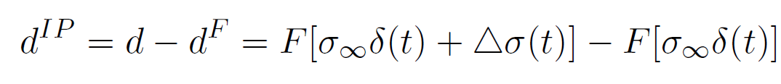
Extension to time domain EM
Decomposition of EM responses
This is our goal:

Slide 14
Our strategy
First linearize JIP
Then use Biot-Savart Law

Slide 15
Details

Slide 16
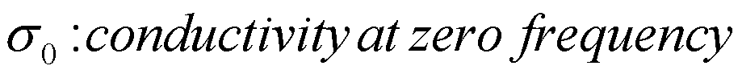
Forward modelling: time domain
Auxiliary equations approach
Marchant et al. (2014)
Cole-Cole model, c = 1
A tool to compute Airborne TEM-IP responses
Backgrounds
Conceptual model
d^{IP} responses
Linear inversion
Mt. Milligan data
Notes:
Maybe a slide with a few Frequency domain conductivities and the representative sigma(t)
Equations written in convolution format

Slide 17
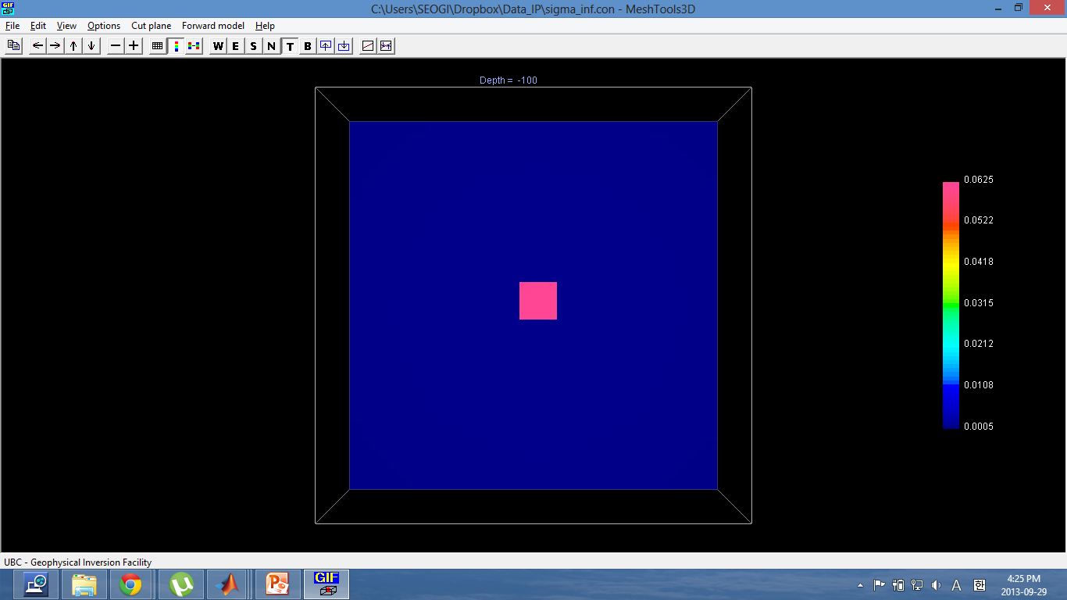
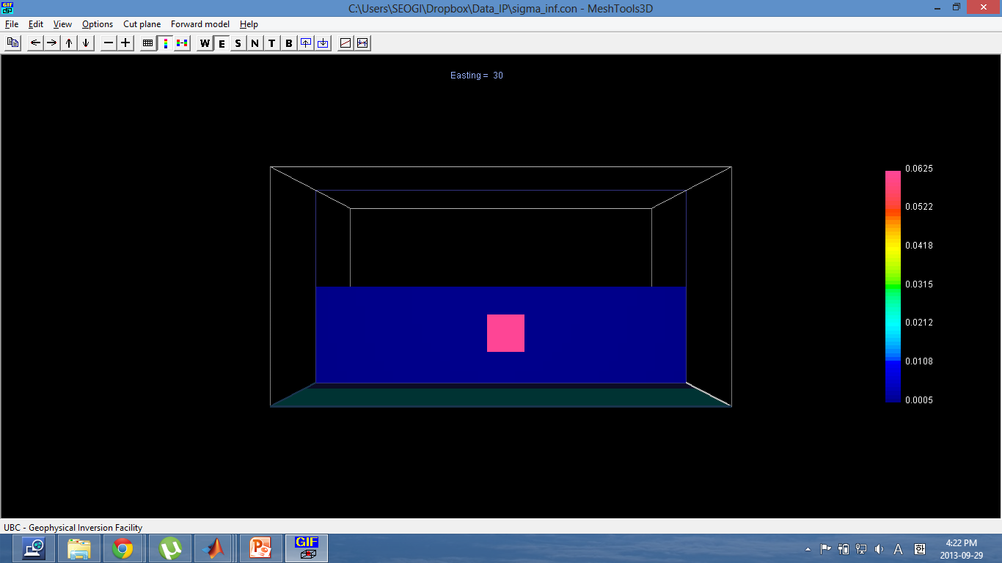
Synthetic example
Conductivity model
800 m
Discretization
- 20 m core cells
- 69 x 69 x 50 cells
Background
σ_{half} = 5e-4 S/m
Target
- σ∞ = 5e-4 S/m
- η = 0.2
- τ = 0.01
- 80m x 80m x 80m
- 60m below surface
North-South
800 m
East-West
-60
Depth (m)
-160
-400
-30
50
400
East-West (m)
Backgrounds
Conceptual model
d^{IP} responses
Linear inversion
Mt. Milligan data

Slide 18
Synthetic example
IP model
800 m
Discretization
- 20 m core cells
- 69 x 69 x 50 cells
Background
σ_{half} = 5e-4 S/m
Target
- σ∞ = 5e-4 S/m
- η = 0.2
- τ = 0.01
- 80m x 80m x 80m
- 60m below surface
North-South
800 m
East-West
-60
Depth (m)
-160
-400
-30
50
400
East-West (m)
Backgrounds
Conceptual model
d^{IP} responses
Linear inversion
Mt. Milligan data

Slide 19
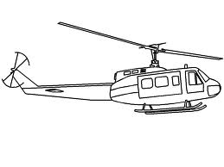
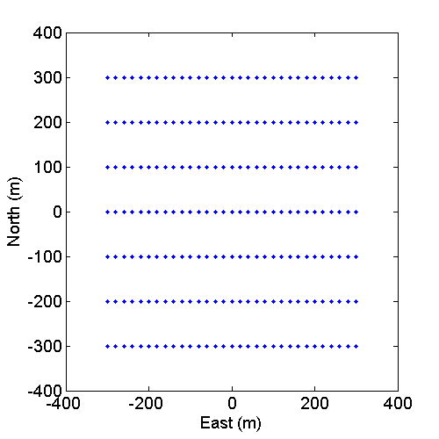
Synthetic example
Geometry
VMD source
- 30m above surface
- Coincident loop
- Step-off waveform
7×14 = 112 Tx-Rx pair
Receivers
- Collocated with Tx
- Measuring db/dt
- 10⁻⁵ – 10⁻¹ seconds
Backgrounds
Conceptual model
d^{IP} responses
Linear inversion
Mt. Milligan data

Slide 20
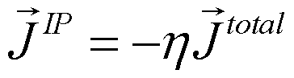
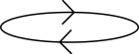


ATEM-IP case: Conceptual model
J ^{IP}
I (current)
z
y
x
J ^{EM}
J ^{IP}
EMIP: with IP effect
EM: without IP effect
J ^{IP}
J^{EMIP} = J^{EM}+J^{IP}
Backgrounds
Conceptual model
d^{IP} responses
Linear inversion
Mt. Milligan data
Notes:
It seems that something wrong need to ask dikun?

Slide 21
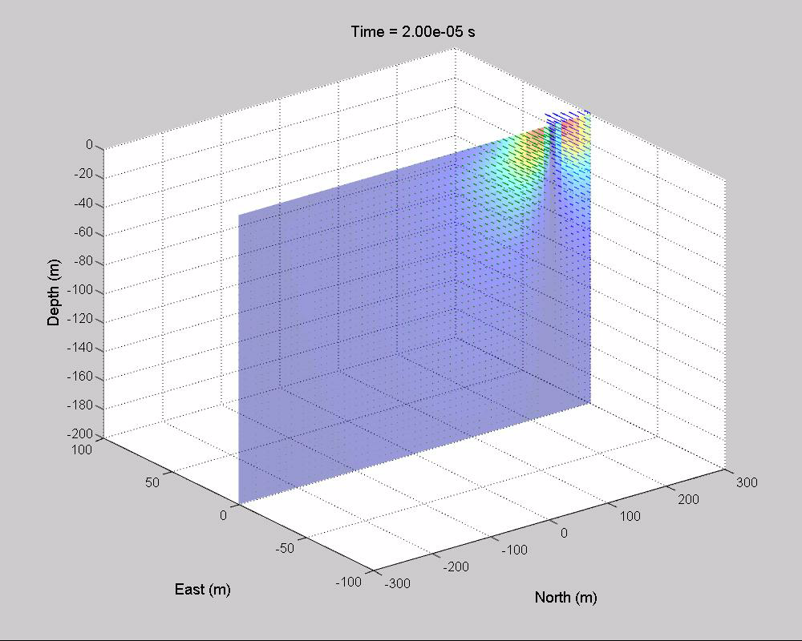
ATEM case without IP effect (EM)
Total current density (J^{total}) section
z
y
x
J ^{EM}
Backgrounds
Conceptual model
d^{IP} responses
Linear inversion
Mt. Milligan data
Notes:
It seems that something wrong need to ask dikun?

Slide 22
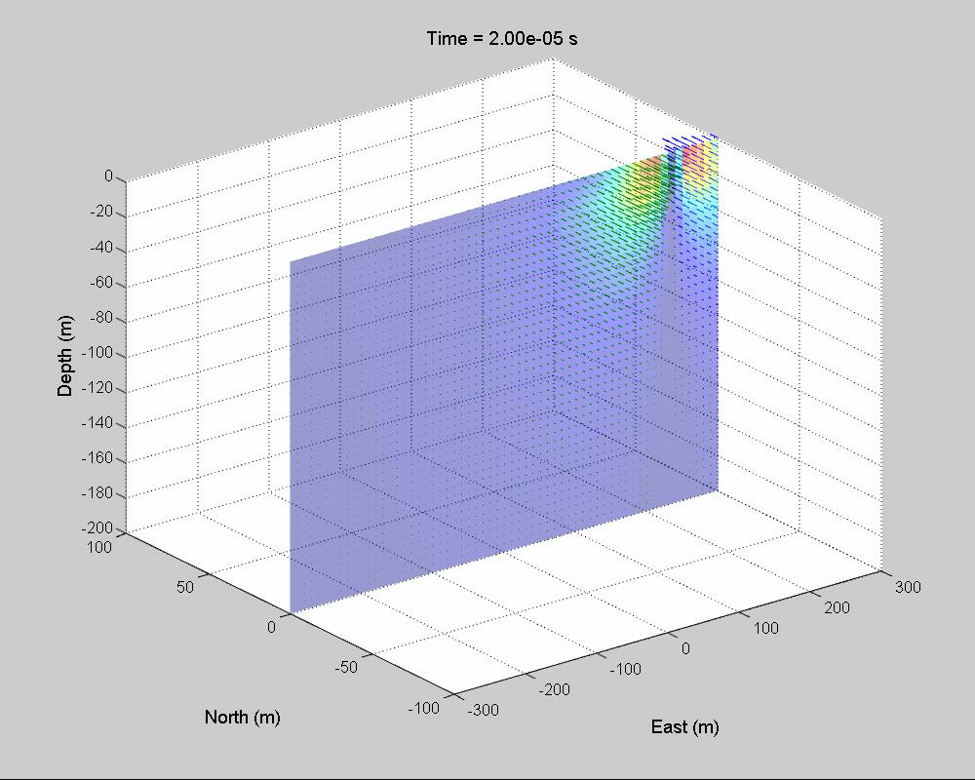
ATEM case with IP effect (EMIP)
Total current density (J^{total}) section
I (current)
z
y
x
J ^{EM}
J ^{IP}
Backgrounds
Conceptual model
d^{IP} responses
Linear inversion
Mt. Milligan data
Notes:
It seems that something wrong need to ask dikun?

Slide 23
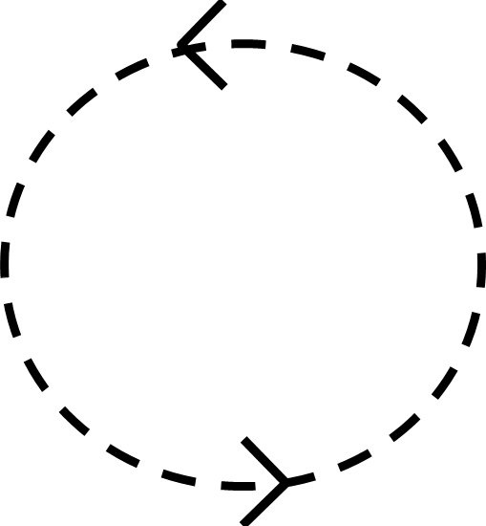
ATEM IP effect
Plan view
North
J^{total} without IP
J^{total} with IP
East
J ^{EM}
J ^{EM}
J ^{IP}
I (current)
I (current)
J^{EMIP} = J^{EM}+J^{IP}
Backgrounds
Conceptual model
d^{IP} responses
Linear inversion
Mt. Milligan data
Notes:
It seems that something wrong need to ask dikun?

Slide 24
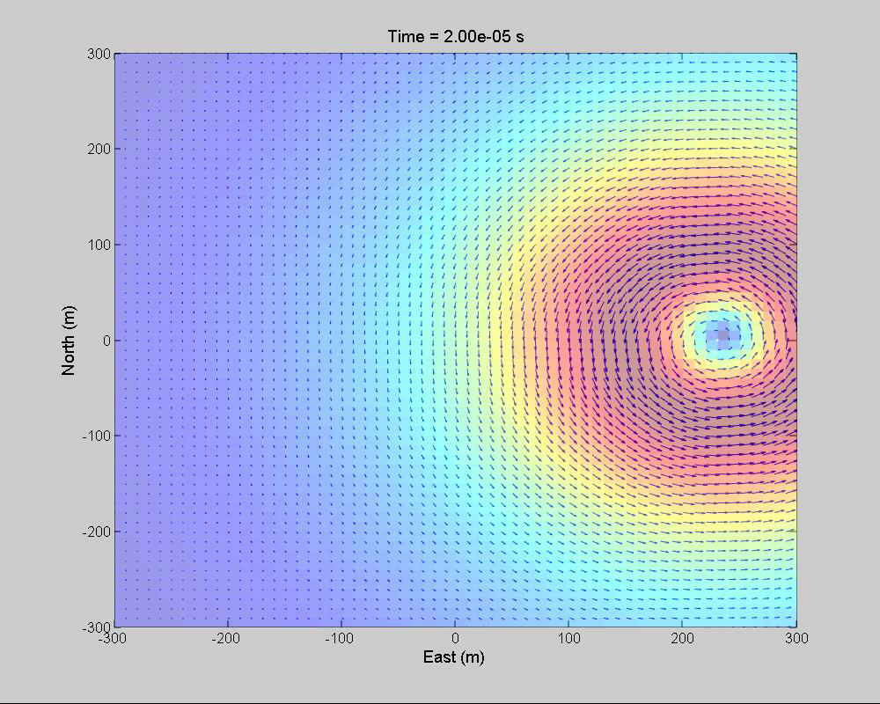

ATEM IP effect
Plan view
North
J^{total} without IP
J^{total} with IP
East
J ^{EM}
J ^{EM}
J ^{IP}
Compatible with conceptual model
More chances to observe IP response in late times
Backgrounds
Conceptual model
d^{IP} responses
Linear inversion
Mt. Milligan data
Notes:
It seems that something wrong need to ask dikun?

Slide 25
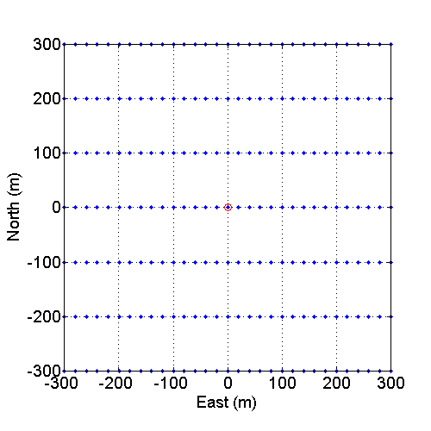
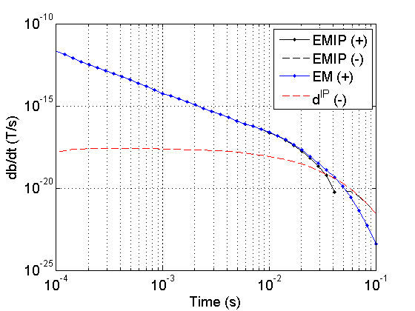
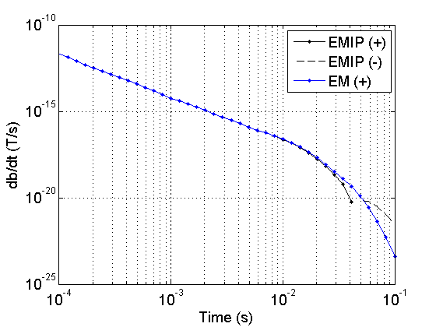
Measured ATEM responses
σ (t) = σ∞δ (t) +∆σ (t)
db/dt response at (0, 0)
ATEM responses
EMIP: with IP effect
EM: without IP effect
EM decoupling process
EMIP = F[σ∞+∆σ(t)]
EM = F [σ∞]
d^{IP} = F [σ∞+∆σ(t)]- F [σ∞]
d^{IP}
F[σ∞δ (t) +∆σ (t)]
F[σ∞δ (t)]
Backgrounds
Conceptual model
d^{IP} responses
Linear inversion
Mt. Milligan data
Notes:
It seems that something wrong need to ask dikun?

Slide 26
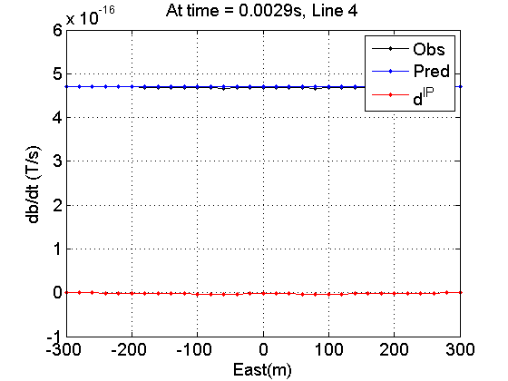



Synthetic Airborne EM data
db/dt data at time = 0.0029s
db/dt (T/s)
db/dt (T/s)
db/dt (T/s)
Backgrounds
Conceptual model
d^{IP} responses
Linear inversion
Mt. Milligan data
Notes:
It seems that something wrong need to ask dikun?

Slide 27


Synthetic Airborne EM data
db/dt data at time = 0.012s
db/dt (T/s)
db/dt (T/s)
db/dt (T/s)
Backgrounds
Conceptual model
d^{IP} responses
Linear inversion
Mt. Milligan data
Notes:
It seems that something wrong need to ask dikun?

Slide 28


Synthetic Airborne EM data
db/dt data at time = 0.049s
d^{IP}
F[σ∞δ (t) +∆σ (t)]
F[σ∞δ (t)]
Accurate estimation of background model (σ∞) is crucial
db/dt (T/s)
db/dt (T/s)
db/dt (T/s)
Backgrounds
Conceptual model
d^{IP} responses
Linear inversion
Mt. Milligan data
Notes:
It seems that something wrong need to ask dikun?

Slide 29

Need background conductivity (σ∞)
Carry out 3D inversion of the AEM data (leave out time channels that have negative transients)
Methodology: Yang and Oldenburg [AGU, 2012, ASEG 2012]
Local mesh for forward modelling and sensitivities
Stochastic selection of transmitters
Backgrounds
Conceptual model
d^{IP} responses
Linear inversion
Mt. Milligan data

Slide 30




Linearization of EMIP responses
Cole-Cole model (c = 1)
Linearization
Pseudo chargeability
Backgrounds
Conceptual model
d^{IP} responses
Linear inversion
Mt. Milligan data

Slide 31




Linear Inversion
3D volume of
At each time
Backgrounds
Conceptual model
d^{IP} responses
Linear inversion
Mt. Milligan data

Slide 32





Recovered pseudo chargeability
For three different time channels
t = 1.2 ms
t = 2.4 ms
t = 10 ms
True
-60
Depth (m)
-160
Estimated
-400
-30
50
400
East (m)
Pseudo chargeability c=1
Pseudo chargeability
Backgrounds
Conceptual model
d^{IP} responses
Linear inversion
Mt. Milligan data

Slide 33
Procedure for ATEM-IP inversion
Attempt to avoid soundings/times that have IP coupling effects
Easy if there are negative transients
Invert TEM to recover a background 3D σ model
Compute d^{IP} data at multiple time channels
Assume IP data are composed of a smoothly varying regional plus true IP data
Estimate a regional field
??
Subtract regional to obtain
IP data
Not easy; but this issue is confronted before
Invert individual
time channels
Backgrounds
Conceptual model
d^{IP} responses
Linear inversion
Mt. Milligan data

Slide 34

Mt. Milligan Airborne EM data
db/dt data at time = 0.00463s
Observed
Predicted
d^{IP}
Backgrounds
Conceptual model
d^{IP} responses
Linear inversion
Mt. Milligan data
Notes:
From the data we observe the effects of the large negative but there are also other minima.
Unfortunately there seems to be systematic biases and we’ve attempted to remove these with the idea that the broad background should be non-chargeable. This is akin to removing a regional and there is the possibiity of throwing the baby out with the bathwater.
Persevere to get …

Slide 35

Mt. Milligan Airborne EM data
db/dt data at time = 0.00473s
Observed
Predicted
d^{IP}
Backgrounds
Conceptual model
d^{IP} responses
Linear inversion
Mt. Milligan data
Notes:
From the data we observe the effects of the large negative but there are also other minima.
Unfortunately there seems to be systematic biases and we’ve attempted to remove these with the idea that the broad background should be non-chargeable. This is akin to removing a regional and there is the possibiity of throwing the baby out with the bathwater.
Persevere to get …

Slide 36

Mt. Milligan Airborne EM data
db/dt data at time = 0.00488s
Observed
Predicted
d^{IP}
Backgrounds
Conceptual model
d^{IP} responses
Linear inversion
Mt. Milligan data
Notes:
From the data we observe the effects of the large negative but there are also other minima.
Unfortunately there seems to be systematic biases and we’ve attempted to remove these with the idea that the broad background should be non-chargeable. This is akin to removing a regional and there is the possibiity of throwing the baby out with the bathwater.
Persevere to get …

Slide 37

Mt. Milligan Airborne EM data
db/dt data at time = 0.00508s
Observed
Predicted
d^{IP}
Backgrounds
Conceptual model
d^{IP} responses
Linear inversion
Mt. Milligan data
Notes:
From the data we observe the effects of the large negative but there are also other minima.
Unfortunately there seems to be systematic biases and we’ve attempted to remove these with the idea that the broad background should be non-chargeable. This is akin to removing a regional and there is the possibiity of throwing the baby out with the bathwater.
Persevere to get …

Slide 38

Mt. Milligan Airborne EM data
db/dt data at time = 0.00537s
Observed
Predicted
d^{IP}
Backgrounds
Conceptual model
d^{IP} responses
Linear inversion
Mt. Milligan data
Notes:
From the data we observe the effects of the large negative but there are also other minima.
Unfortunately there seems to be systematic biases and we’ve attempted to remove these with the idea that the broad background should be non-chargeable. This is akin to removing a regional and there is the possibiity of throwing the baby out with the bathwater.
Persevere to get …

Slide 39

Mt. Milligan Airborne EM data
db/dt data at time = 0.00577s
Observed
Predicted
d^{IP}
Backgrounds
Conceptual model
d^{IP} responses
Linear inversion
Mt. Milligan data
Notes:
From the data we observe the effects of the large negative but there are also other minima.
Unfortunately there seems to be systematic biases and we’ve attempted to remove these with the idea that the broad background should be non-chargeable. This is akin to removing a regional and there is the possibiity of throwing the baby out with the bathwater.
Persevere to get …

Slide 40

Mt. Milligan Airborne EM data
db/dt data at time = 0.00635s
Observed
Predicted
d^{IP}
Backgrounds
Conceptual model
d^{IP} responses
Linear inversion
Mt. Milligan data
Notes:
From the data we observe the effects of the large negative but there are also other minima.
Unfortunately there seems to be systematic biases and we’ve attempted to remove these with the idea that the broad background should be non-chargeable. This is akin to removing a regional and there is the possibiity of throwing the baby out with the bathwater.
Persevere to get …

Slide 41

Mt. Milligan Airborne EM data
db/dt data at time = 0.00715s
Observed
Predicted
d^{IP}
Backgrounds
Conceptual model
d^{IP} responses
Linear inversion
Mt. Milligan data
Notes:
From the data we observe the effects of the large negative but there are also other minima.
Unfortunately there seems to be systematic biases and we’ve attempted to remove these with the idea that the broad background should be non-chargeable. This is akin to removing a regional and there is the possibiity of throwing the baby out with the bathwater.
Persevere to get …

Slide 42
Observed data for all channels
Backgrounds
Conceptual model
d^{IP} responses
Linear inversion
Mt. Milligan data
Notes:
From the data we observe the effects of the large negative but there are also other minima.
Unfortunately there seems to be systematic biases and we’ve attempted to remove these with the idea that the broad background should be non-chargeable. This is akin to removing a regional and there is the possibiity of throwing the baby out with the bathwater.
Persevere to get …

Slide 43



d^{IP} data for all channels
We can better identify d^{IP} through this processing
Backgrounds
Conceptual model
d^{IP} responses
Linear inversion
Mt. Milligan data
Observed
Predicted
Notes:
From the data we observe the effects of the large negative but there are also other minima.
Unfortunately there seems to be systematic biases and we’ve attempted to remove these with the idea that the broad background should be non-chargeable. This is akin to removing a regional and there is the possibiity of throwing the baby out with the bathwater.
Persevere to get …

Slide 44



Removal of a regional
d^{IP}
regional
data for inversion
Backgrounds
Conceptual model
d^{IP} responses
Linear inversion
Mt. Milligan data

Slide 45



Inversion Results
Depth=20m
Depth=40m
Depth=60m
Backgrounds
Conceptual model
d^{IP} responses
Linear inversion
Mt. Milligan data

Slide 46
Summary and path forward
We can measure negative transients, which may indicate existence of IP body with VTEM
Build up conceptual model based on Seigel (1959)
and verified with numerical experiments
Use EMTDIP code developed by Marchant et al., 2012
Better identify IP responses in ATEM-IP data
EMIP or observed
EM or predicted from TEM inversion

Slide 47
Summary and path forward
Estimate σ∞ , 3D background conductivity
Use efficient 3D ATEM inversion algorithm developed by Yang and Oldenburg (2012)
Recovered 3D distribution of pseudo chargeability
Current progress provides optimism that we can invert the data if it is sufficiently high quality

Slide 48
Thank you ☺

Slide 49


Effects of background conductivity
True
background (σ∞)
Wrong
Background (2×σ∞)
Wrong
background (0.5×σ∞)
Notes:
It seems that something wrong need to ask dikun?

Slide 50



Slide 51


Acknowledgements
This work was carried out under NSERC CRD and IRC programs and sponsoring companies: Cameco, Teck, Newmont, Barrick, Vale, Xstrata Nickel and Anglo American.
The authors thank Roman Shekhtman for his assistance in programming.
Dikun Yang, Dave Marchant

Slide 52


Slide 53
Comparison between d^{IP} and σ
m
10⁻¹
10^{-1.2}
10^{-1.4}
10^{-1.6}
10^{-1.8}
dh_{z}/dt (A/m-s)
10^{-2.0}
Conductivity (S/m)
10^{-2.2}
10^{-2.4}
10^{-2.6}
10^{-2.8}
10⁻³
×10
Backgrounds
Conceptual model
d^{IP} responses
Linear inversion
Mt. Milligan data

Slide 54

Where are IP bodies?
Backgrounds
Conceptual model
d^{IP} responses
Linear inversion
Mt. Milligan data

Slide 55
Where are IP bodies?
Backgrounds
Conceptual model
d^{IP} responses
Linear inversion
Mt. Milligan data

Slide 56

Where are IP bodies?
Anomalous σ
Anomalous d^{IP}
Hard to identify even from d^{IP} responses
Need to apply inversion technique
Backgrounds
Conceptual model
d^{IP} responses
Linear inversion
Mt. Milligan data

Slide 57


How do we do geophysics?
1. Identification of anomalous responses in the data
Negative transients of db/dt
Good ☺
2. Try to rationalize these responses based on physics
Need to build up conceptual model
Lots of things to do ☺
3. Extract information of the subsurface as much as we can
Processing
Geophysical inversion
How to better identify IP responses?
How to invert these responses?

Slide 58


Recovered pseudo chargeability
Time decaying at one pixel
Pseudo chargeability c=1
-60
Depth (m)
We solve this … for
-160
-400
-30
50
400
East (m)
Pseudo chargeability
Backgrounds
Conceptual model
d^{IP} responses
Linear inversion
Mt. Milligan data

